Slide 1
Graph Representation

Slide 2
Adjacency Lists

Slide 3
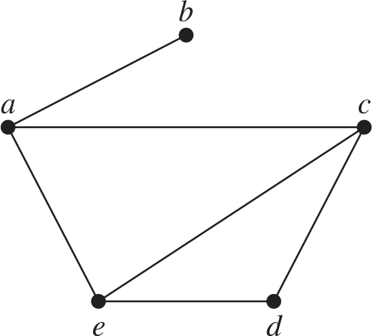
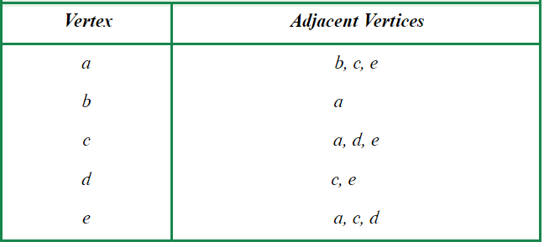
What Is an Adjacency List?
adjacency list

Slide 4
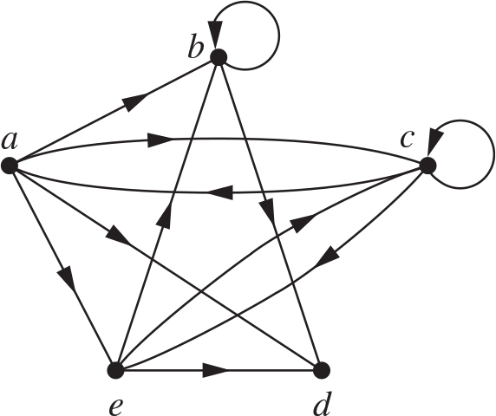
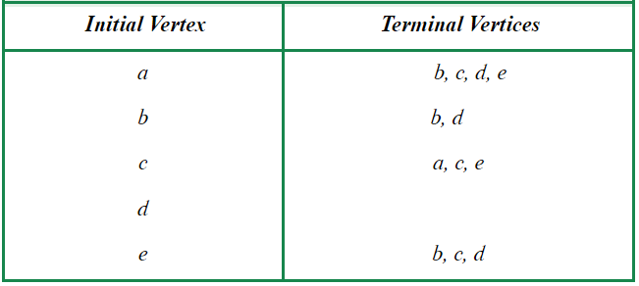
Adjacency Lists for Directed Graphs
adjacency list

Slide 5
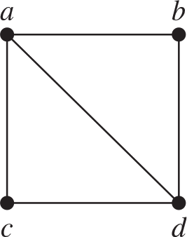
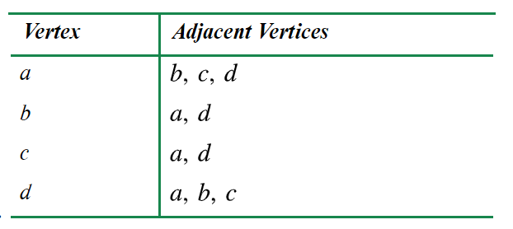
Exercise 1: Find the Adjacency Lists

Slide 6
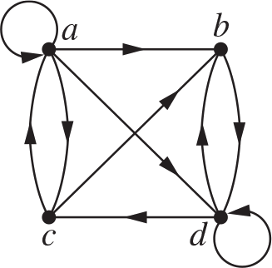
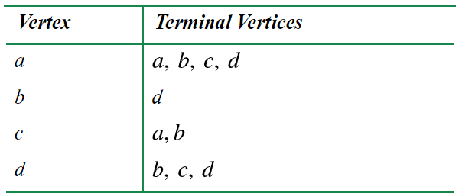
Exercise 2: Find the Adjacency Lists

Slide 7
Adjacency Matrices

Slide 8
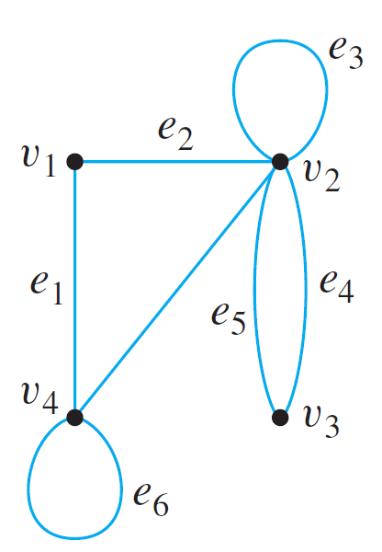
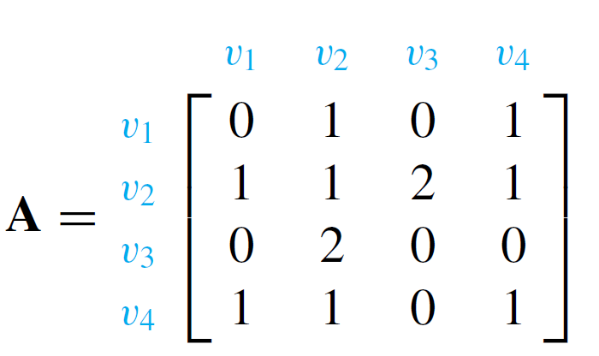

Definition
Let $G$ be a graph with vertices $v_{1},…, v_{n}$. The adjacency matrix for $G$ is the $n×n$ matrix $A=[a_{ij}]$ where $a_{ij}$ is the number of edges whose endpoints are $v_{i}$ and $v_{j}$.
Example

Slide 9
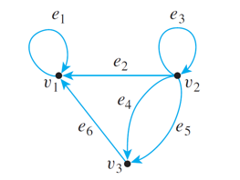
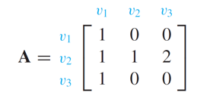

Definition
Let $G$ be a directed graph with vertices $v_{1},…, v_{n}$. The adjacency matrix for $G$ is the $n×n$ matrix $A=[a_{ij}]$ where $a_{ij}$ is the number of edges from $v_{i}$ to $v_{j}$.
Example

Slide 10
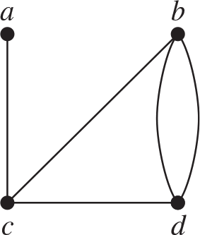
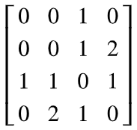
Exercise 1: Find the Adjacency Matrix

Slide 11
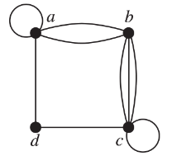
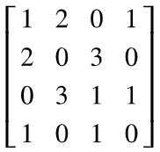
Exercise 2: Draw the Graph

Slide 12
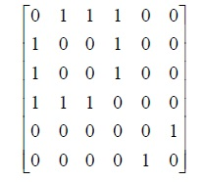
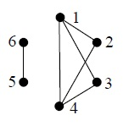
Exercise 3: Draw the Graph

Slide 13
Incidence Matrices

Slide 14
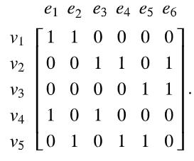
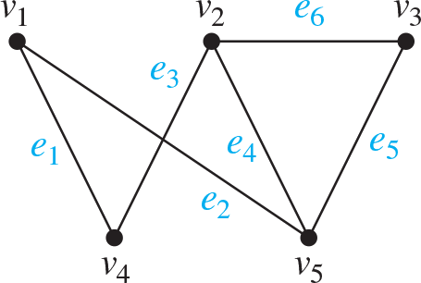
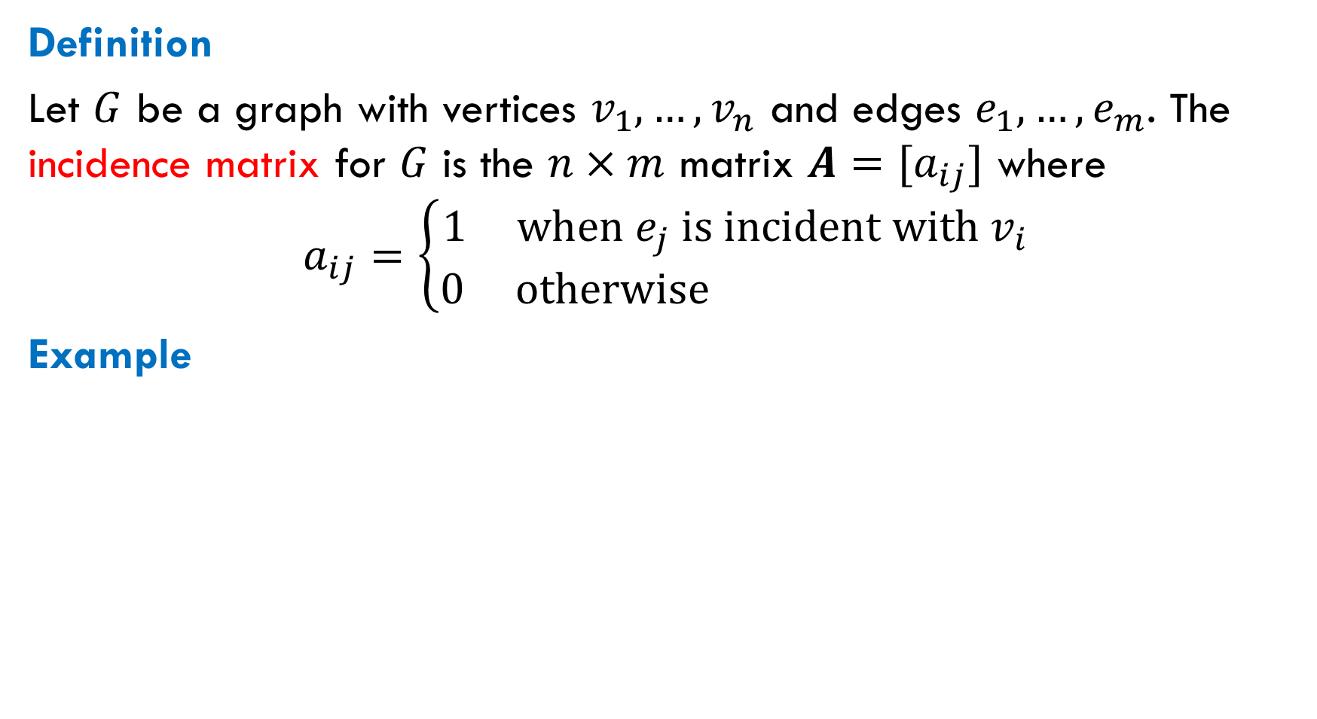
Definition
Let $G$ be a graph with vertices $v_{1},…, v_{n}$ and edges $e_{1},…, e_{m}$. The incidence matrix for $G$ is the $n×m$ matrix $A=[a_{ij}]$ where
$$a_{ij}=\left\{\begin{aligned}1 \text{when} e_{j} \text{is} \text{incident} \text{with} v_{i} \\ 0 \text{otherwise} \end{aligned}\right.$$
Example

Slide 15
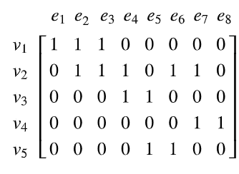
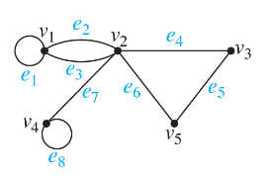
Exercise: Find the Incidence Matrix

Slide 16

Reading
Section 6.2

